Slide 1
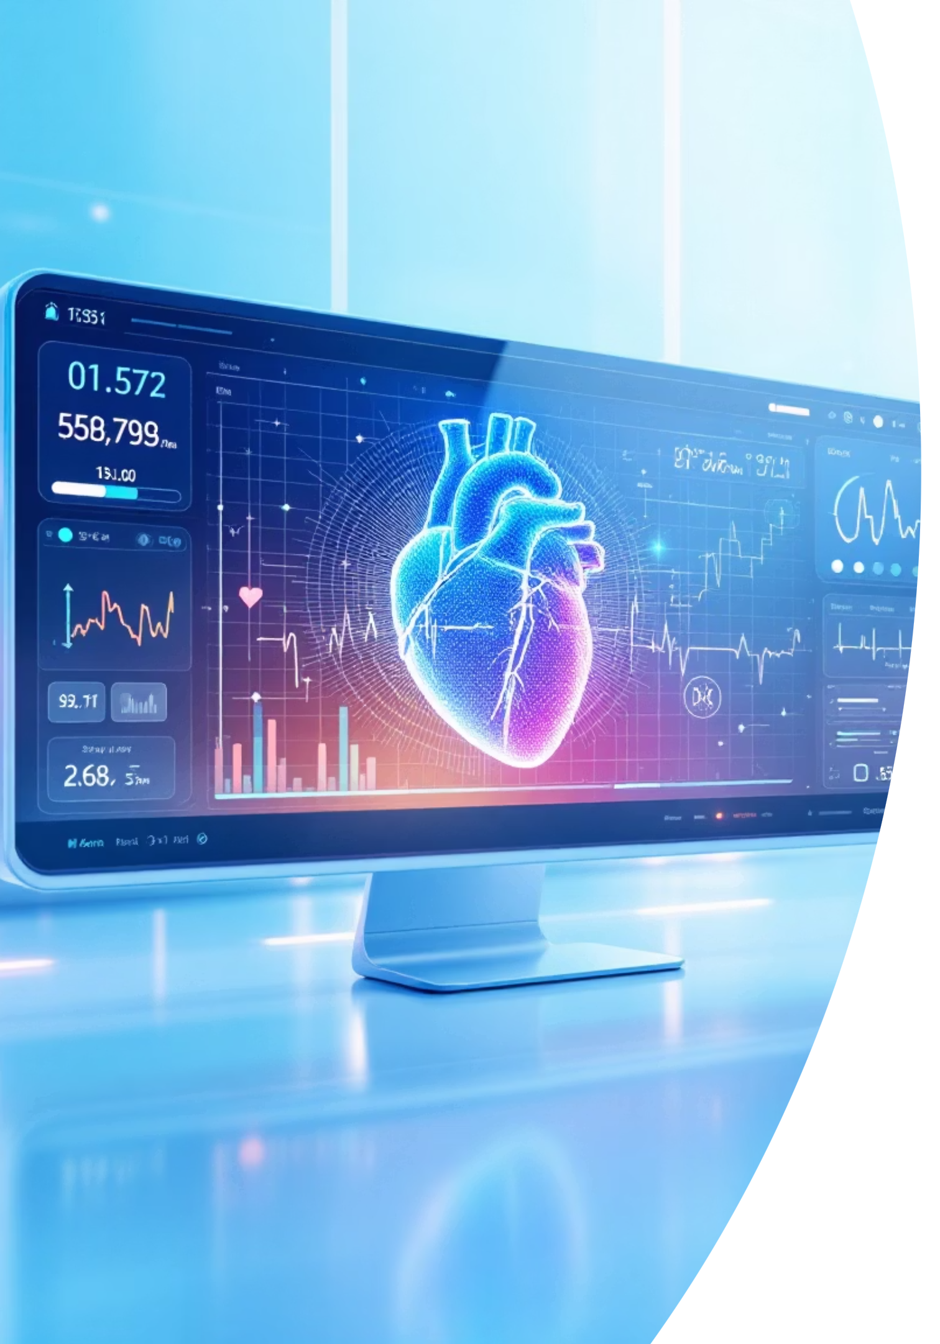
Heart Disease Prediction
Machine learning system for predicting cardiovascular disease risk using patient data and advanced algorithms.
Sonu Kumar
B.Tech ECE 4th sem

Slide 2





PROJECT OVERVIEW
Predicting Heart Disease with AI
Goal
Approach
Predict heart disease risk using patient health metrics
Machine learning models trained on clinical data
Impact
Early detection saves lives through timely intervention

Slide 3




SYSTEM ARCHITECTURE
How It Works
Data Input
Processing
Patient health metrics collected
Label encoders transform data
ML Models
Prediction
Multiple algorithms analyze patterns
Risk assessment generated

Slide 4
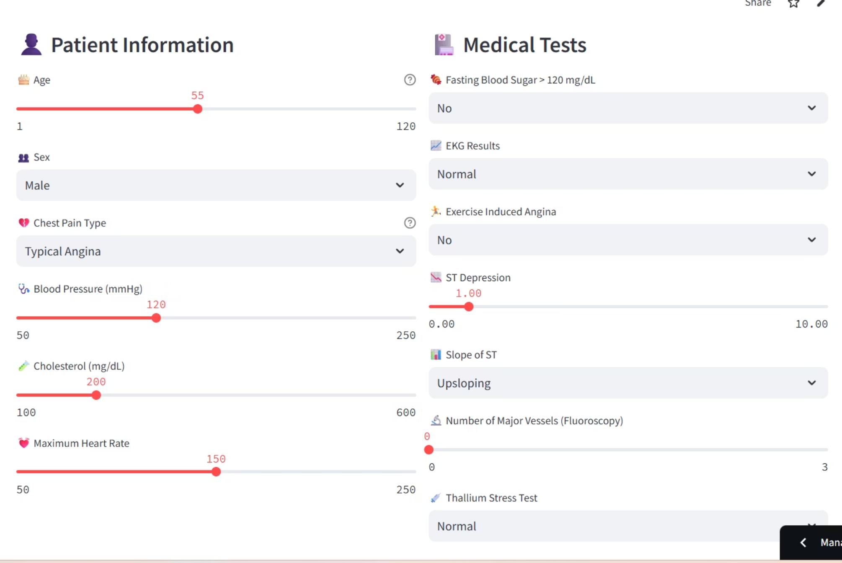
Application Interface
User-Friendly Design
Simple web interface built with Flask allows healthcare providers to input patient data and receive instant predictions.
Clean, intuitive layout
Real-time results
Easy data entry

Slide 5
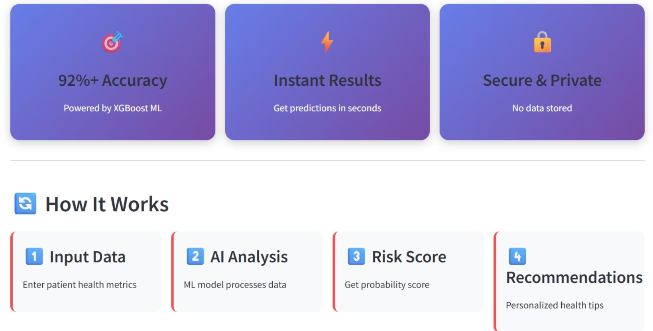
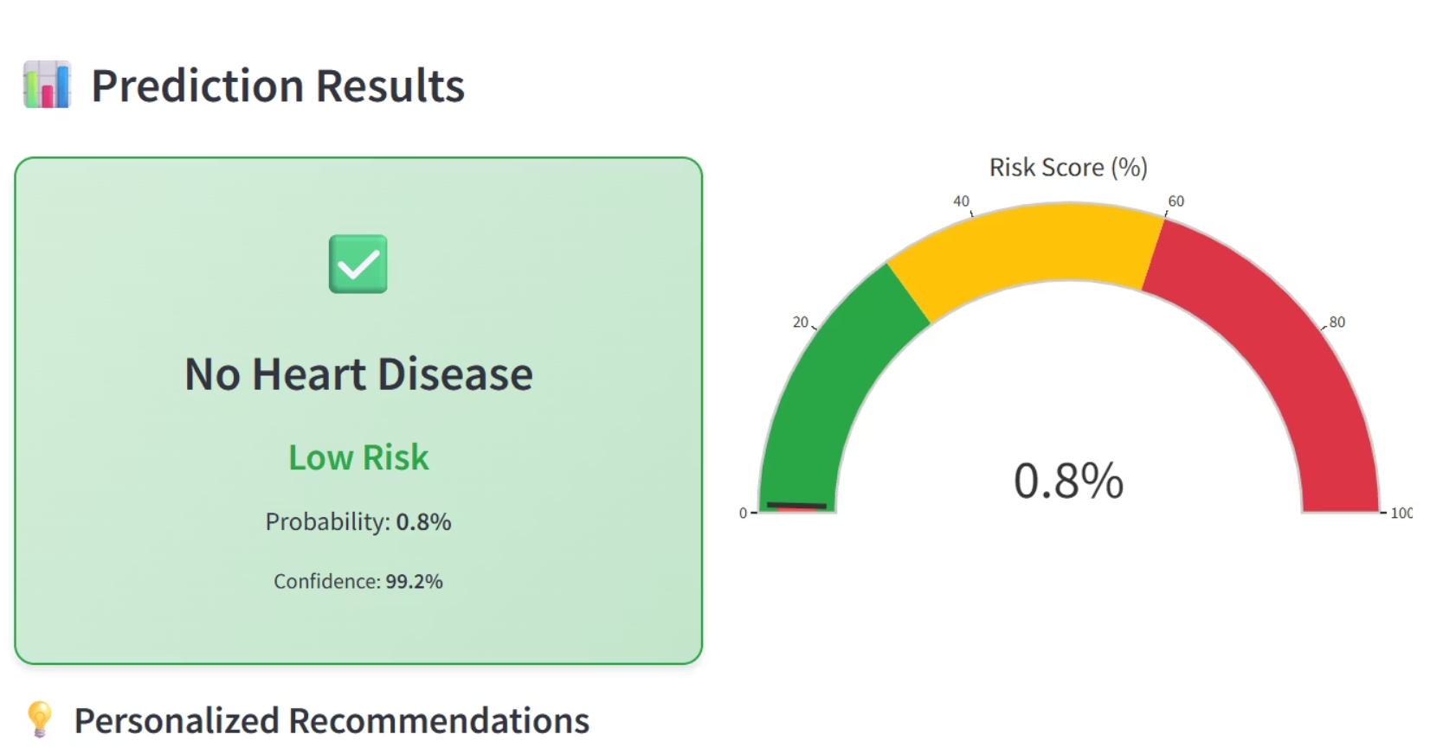
Model Performance
Accuracy Metrics
Validation Results
Multiple models tested for optimal prediction accuracy
Rigorous testing ensures reliable predictions

Slide 6
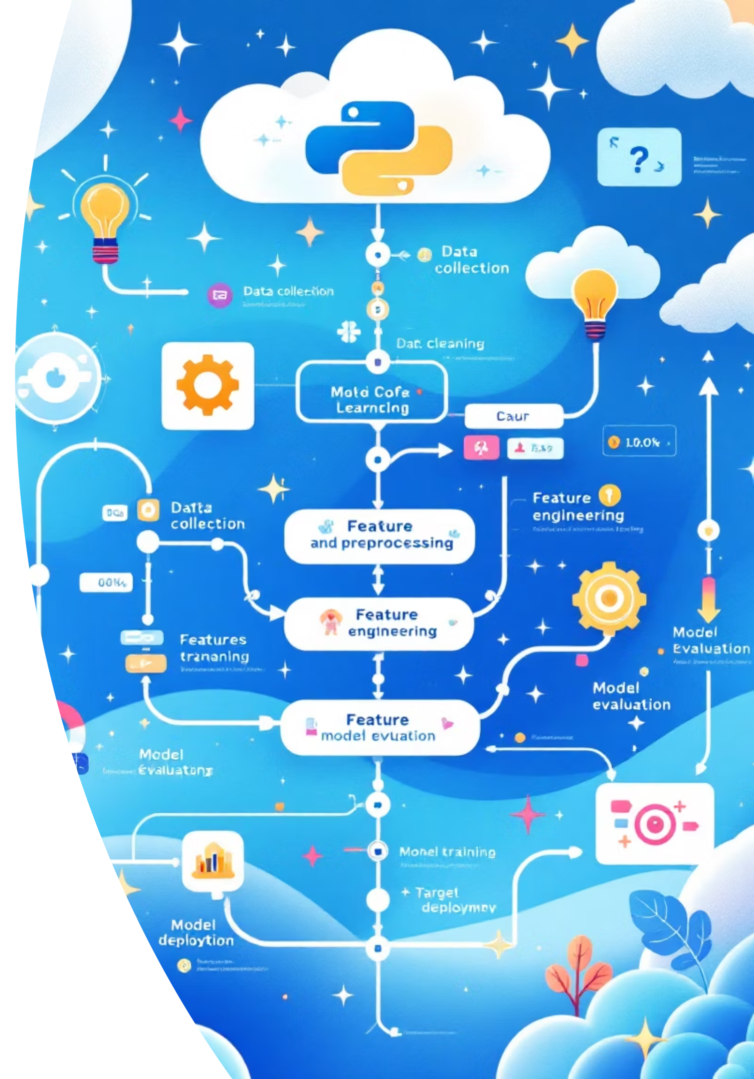
Technical Components
streamlit Application
1
Web framework powering the interface (app.py)
ML Models
2
Trained algorithms stored in models directory
Label Encoders
3
Transform categorical data (label_encoders.pkl)
Target Encoder
4
Process prediction outputs (target_encoder.pkl)

Slide 7

KEY FEATURES
What Makes It Powerful
Real-Time Analysis
Instant predictions enable quick clinical decisions
High Accuracy
Validated models deliver reliable risk assessments
Scalable System
Handles multiple patients efficiently

Slide 8
References
App link:
https://heartdiseaseanalysis-khvdeoxbhwtxkwzgke5b6b.streamlit.app/
Github:
https://github.com/sonuku725020-commits/Heart_Disease_Analysis
linkedin:
https://www.linkedin.com/in/sonu-anand-135599379/

